Slide 1
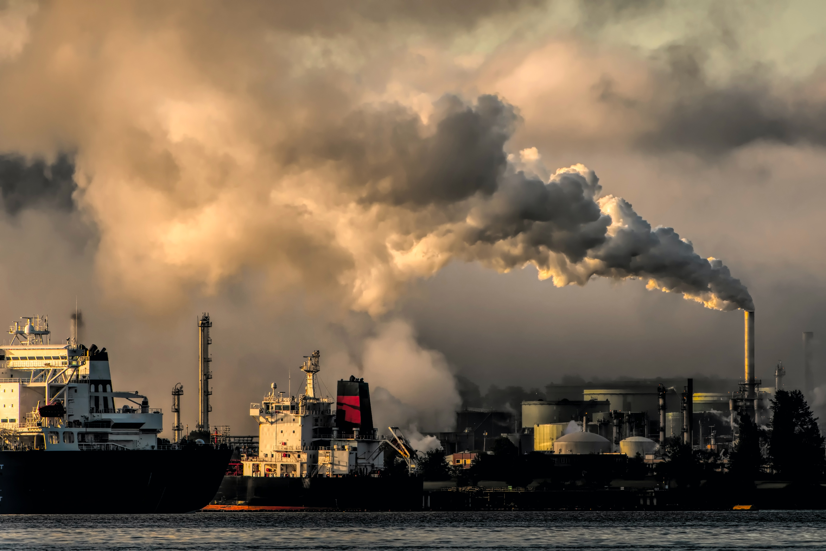
Air quality Index
IE 6600 Computation & Visualization
Project Group 11
Mayur Mahanta
Moheth Muralidharan
Vignesh Sivakumar
Zhibek Kassymkanova

Slide 2
Data description
Satellite Database: https://archive.ics.uci.edu/ml/datasets/air+quality
Dataset Characteristics: Multivariate/Time-Series
Attribute Characteristics: Real
The dataset contains:
9358 instances of hourly averaged responses from an array of 5 metal oxide chemical sensors embedded in an Air Quality Chemical Multisensory Device.
15 Attributes/Features
The device was located on the field in a significantly polluted area, at road level, within an Italian city.
Data were recorded from March 2004 to February 2005 (one year)representing the longest freely available recordings of on field deployed air quality chemical sensor devices responses. Ground Truth hourly averaged concentrations for CO, Non Metanic Hydrocarbons, Benzene, Total Nitrogen Oxides (NOx) and Nitrogen Dioxide (NO2) and were provided by a co-located reference certified analyzer.
Evidences of cross-sensitivities as well as both concept and sensor drifts are present as described in De Vito et al., Sens. And Act. B, Vol. 129,2,2008 (citation required) eventually affecting sensors concentration estimation capabilities.
Missing Values – Yes (Marked with -200)

Slide 3
Data Processing
The dataset had no null values, but some values were set as -200 which were replaced with the mean of the other values in those columns.

Slide 4
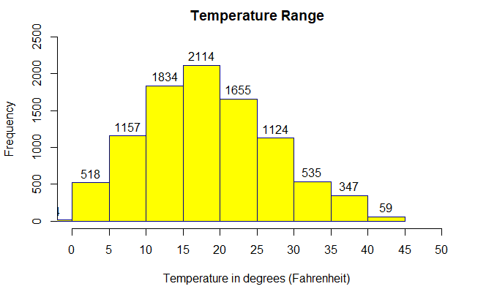
Histogram

Slide 5
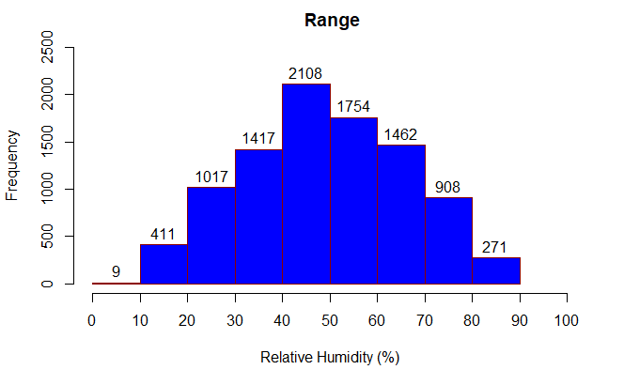
Histogram

Slide 6
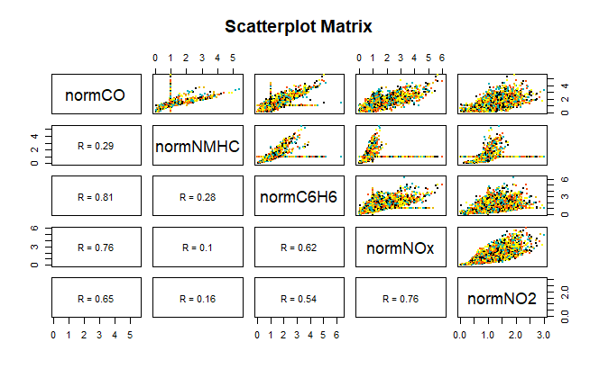
Scatter Plot

Slide 7
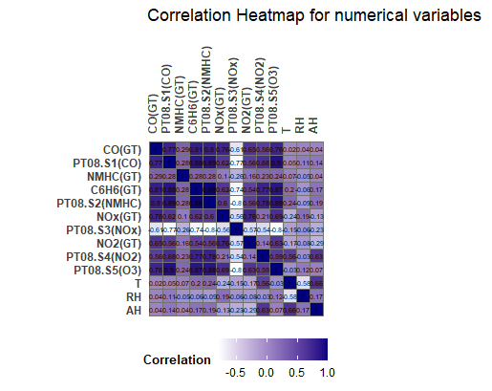
Heat Map

Slide 8
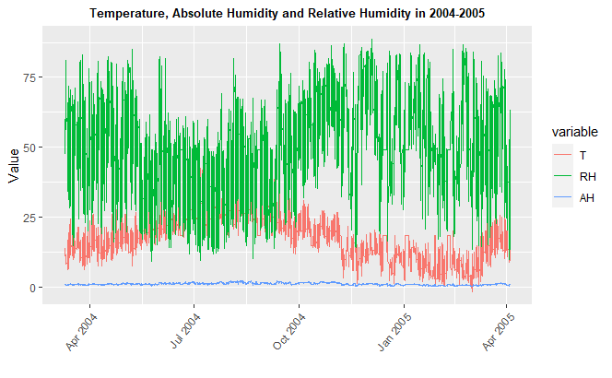
Time Series/Line Graph

Slide 9
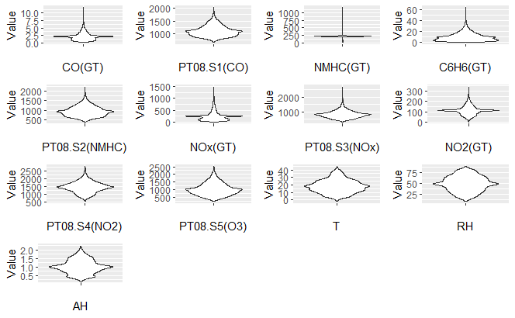
Violin plot

Slide 10
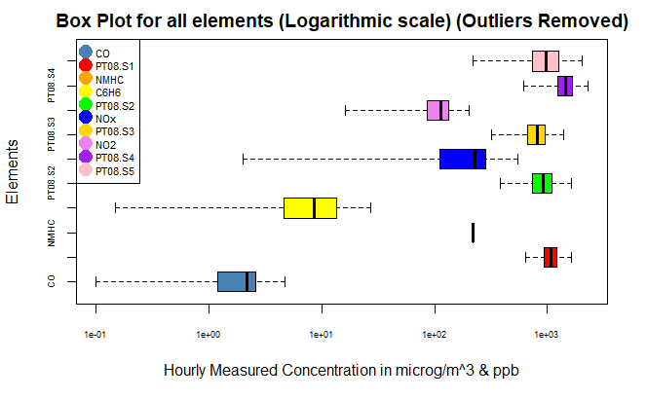
BOXPLOT

Slide 11
THANK YOU

